Slide 1
A Test of TensorRT Refit
Wei Li

Slide 2
Background
Two methods to refit a TensorRT engine from given .onnx
Asumming we have old.onnx and new.onnx,
Now we build a refittable TRT engine model.plan with old.onnx,
Then we want to refit the model.plan with the weight from new.onnx,
tensorrt
old.onnx
model.plan
new.onnx
refit
model2.plan

Slide 3
Background
Two methods to refit a TensorRT engine from given .onnx
Method 1: Refit with TRT parser
load the old engine (build from old.onnx)
parse a new network with new.onnx
traverse the new network to set weight
refit into old engine

Slide 4
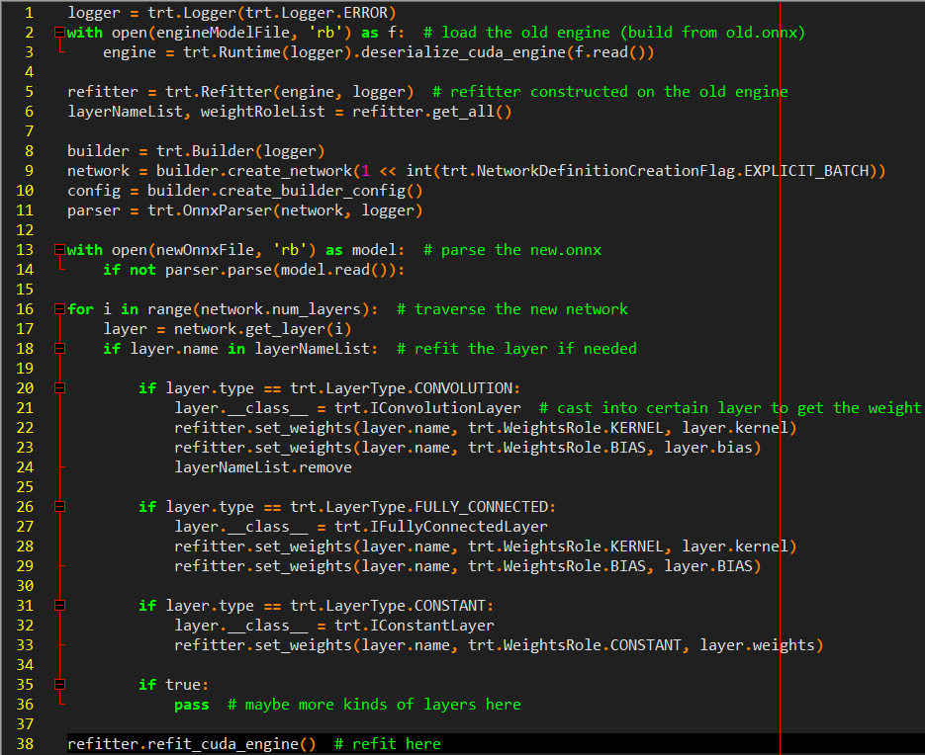

Slide 5
Background
Two methods to refit a TensorRT engine from given .onnx
Method 2: Refit with loaded weights
load the old engine (build from old.onnx)
extract weights from new.onnx (or load weights from .npz)
refit into old engine

Slide 6
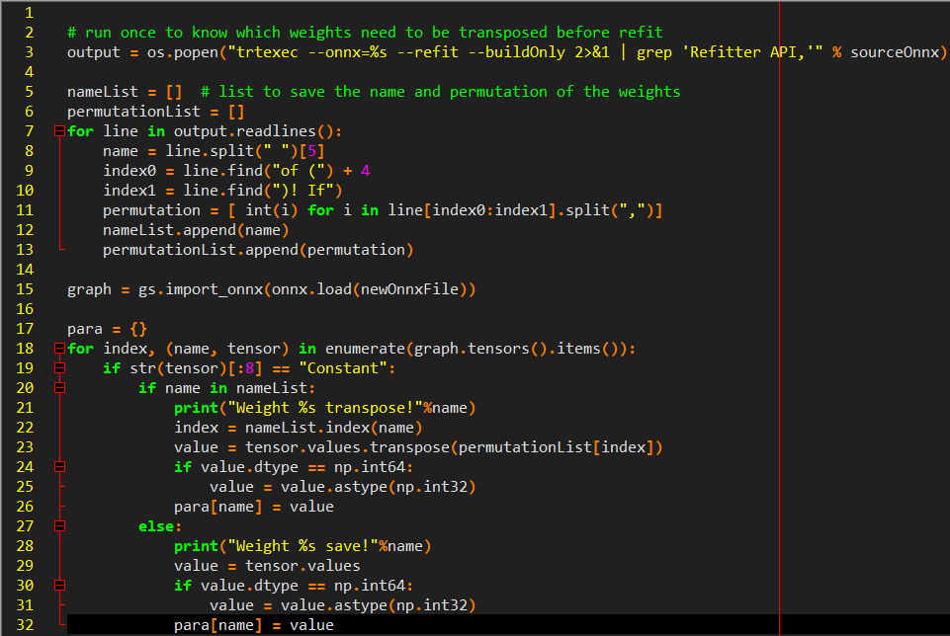
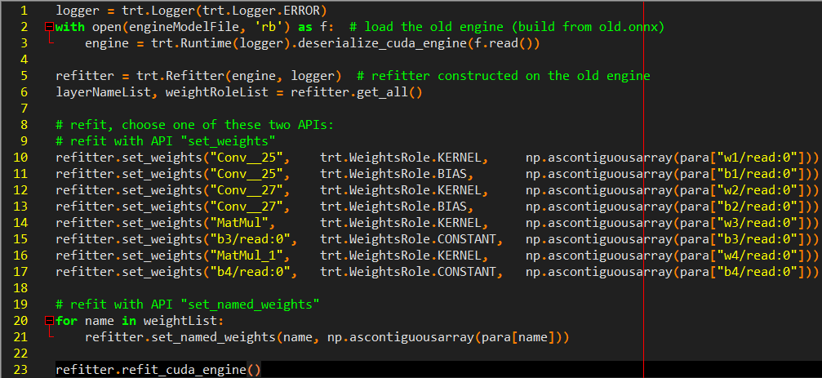
get weight
refit

Slide 7
Comparsion
Method 1:
Eliminate the preprocess of weight adjustment
One script is efficacious for all models
Parse time might be bottleneck when the model is large
Method 2:
Might need the preprocess of weight adjustment manually
Might need unique script to deal with each model

Slide 8
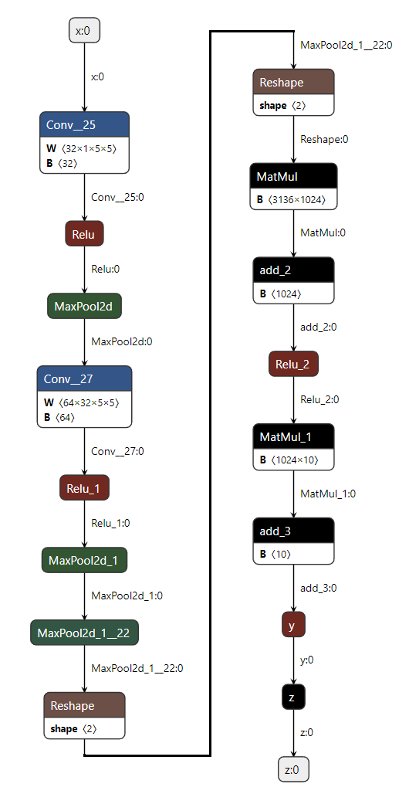
TEST Models
Big Model: Encoder part of Wenet (12 Transformer)
38 Conv + 146 MatMul + other operators
Small Model: A Simple network on MNIST dataset
2 Conv + 2 MatMul (as right graph)

Slide 9
PLATFORM
GPU: A30 (BFS)
docker image:
tensorrt:22.04-py3 (CUDA 11.6.2 + TensorRT8.2.4.2)
tensorrt:22.04-py3 (CUDA 11.6.2 + TensorRT8.4.1.5-GA)

Slide 10
Test Case
Model: Big model / Small mdoel
backend: TRT8.2 / TRT8.4 / Onnxruntime
BatchSize: 1 ~ 1024
Time of GPU inference (excludes memory copy)
Time of Refit with TRT parser (includes parsing new.onnx)
Time of Refit with loading .npz (includes extracting weights from new.onnx)

Slide 11
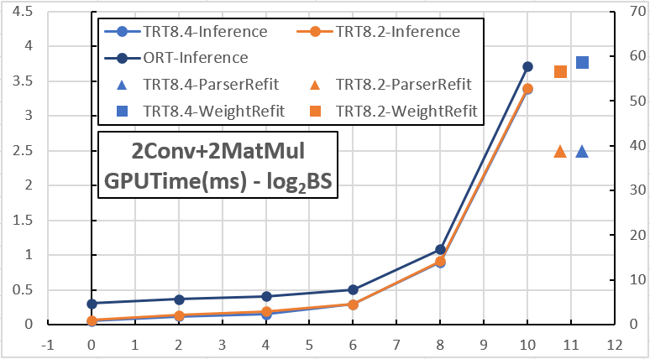
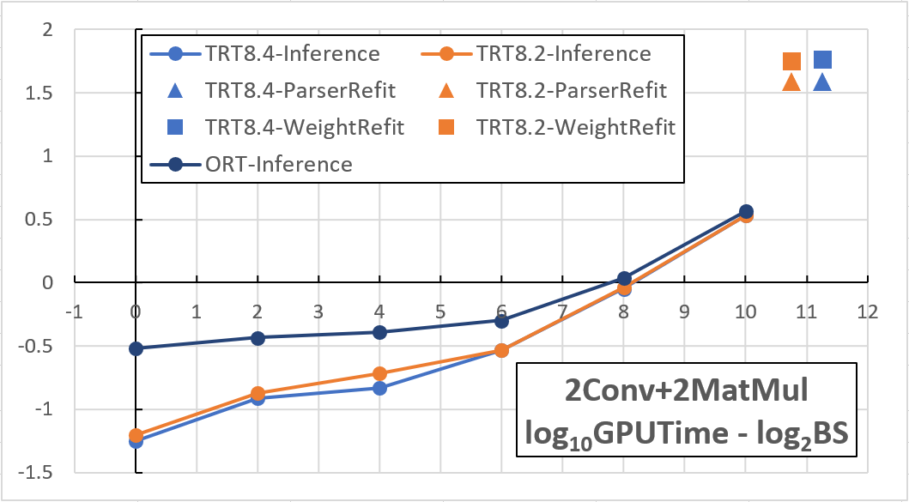
RESULT
Small model
Figure 1
Line: inference time (exclude memory copy, using left Y-axis)
Point: refit time (using right Y-axis)
Figure 2
Just take logarithm of the time variables (using one Y-axis)
Summary
Refit time keeps almost unchanged with different batch size
Refit takes much longer than inference
~810 times (BS=1) and ~14 times (BS=1024)
Refit with TRT Parser is ~49% faster than loading weight
Refit time appears little differences between TRT version
TRT8.4 is slightly faster in inference time when BS is small
1
2

Slide 12
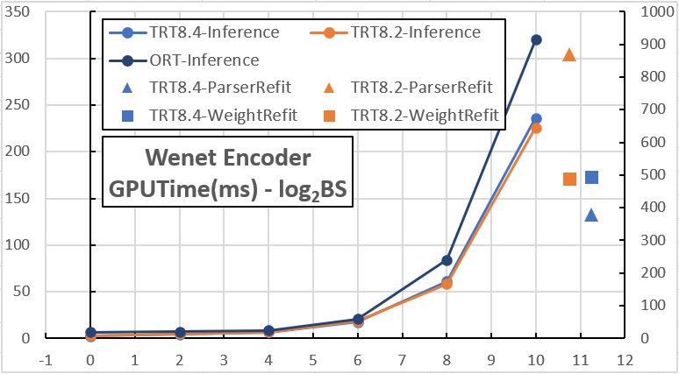
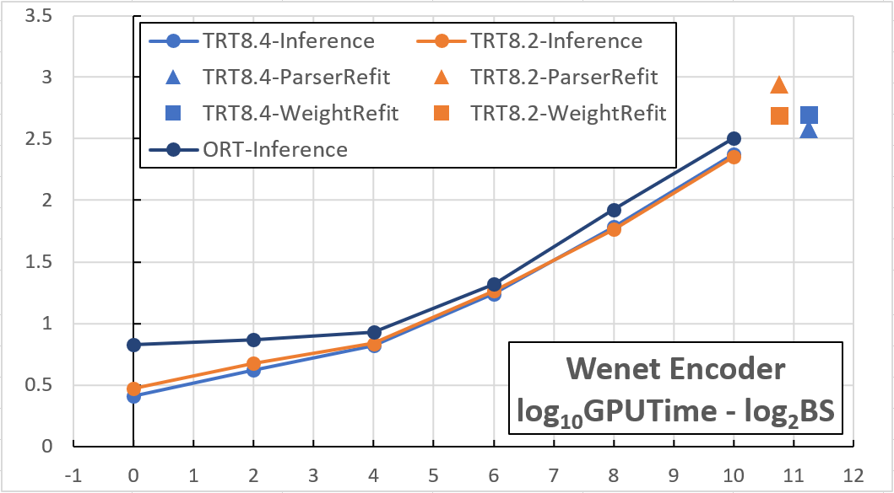
RESULT
Big model
Figure 3 && Figure 4
changes the data of Big model
Summary
Refit cost is relatively small
~191 times (BS=1) and ~2.5 times (BS=1024)
Refit with TRT Parser is ~49% faster than loading weight
Refit time with loading weight keeps unchange in TRT8.2/8.4
TRT8.4 is much faster in parsing .onnx, saving refit time
~130% faster than TRT8.2
3
4

Slide 13
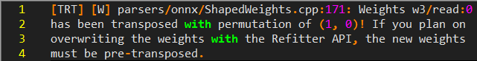
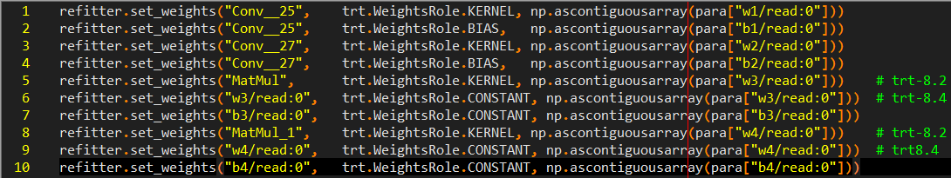
Other TopicS
Interesting tips
Weight adjustment
Both TRT8.2 and TRT8.4 might need preprocess of weights adjustment
TRT8.2 gives warning but TRT8.4 doesn't. (bug?)
Tensor name
The name of Layer/Node/Tensor for refit might be different between TRT versions

Slide 14
Other TopicS
Interesting tips
np. ascontiguousarray
need ascontiguousarray when we implicit cast data from numpy.array into trt.Weights in TensorRT
refitter need its weights wrapped by np.ascontiguousarray
TRT8.2 will skip the problem but leads to incorrect output (Thanks the example from Jie Fang).
TRT8.4 will give an error information (by forbidding the implicit cast? I guess).
TensorRT8.4: max_threads
refitter.max_threads = 8 # increase threads to refit concurrently (from TensorRT/Samples)
does not take effect in this test, need more study
TensorRT8.5: Dynamic shape + Refit
Refit time varies with dynamic shape?

Slide 15
Other TopicS
Interesting tips.onnx
Weight adjustment
Both TRT8.2 and TRT8.4 might need preprocess of weights adjustment
TRT8.2 gives warning but TRT8.4 doesn't. (bug?)
TensorRT/sampels
TensorRT8.5: Dynamic shape
Refit time varies with dynamic shape?
Tensor name
The name of Layer/Node/Tensor for refit might be different between TRT versions

Slide 17
Datasheet of the test
 |  | Method | logBatchSize | 1 | 4 | 16 | 64 | 256 | 1024
Small Model | TRT8.4 | Refit By TRTParser | RefitTime/ms | 38.38524 | 39.670691 | 38.00679 | 38.58246 | 38.363938 | 39.945075
 |  |  | RunTime/ms | 0.056116 | 0.121839 | 0.148343 | 0.292557 | 0.895666 | 3.387953
 |  |  | Ratio | 99.9% | 99.7% | 99.6% | 99.2% | 97.7% | 92.2%
 |  | Refit By Weight | RefitTime/ms | 57.346701 | 57.68965 | 57.527186 | 59.851571 | 58.9773 | 60.917986
 |  |  | RunTime/ms | 0.055826 | 0.123083 | 0.153253 | 0.293842 | 0.899338 | 3.386858
 |  |  | Ratio | 99.9% | 99.8% | 99.7% | 99.5% | 98.5% | 94.7%
 | TRT8.2 | Refit By TRTParser | RefitTime/ms | 37.991035 | 38.893824 | 39.763841 | 39.848351 | 37.852285 | 38.489363
 |  |  | RunTime/ms | 0.063068 | 0.135103 | 0.191427 | 0.294505 | 0.912786 | 3.401773
 |  |  | Ratio | 99.8% | 99.7% | 99.5% | 99.3% | 97.6% | 91.9%
 |  | Refit By Weight | RefitTime/ms | 60.0112123 | 56.4532527 | 55.4080956 | 58.63845 | 54.0630168 | 55.0373941
 |  |  | RunTime/ms | 0.064369 | 0.136928 | 0.188597 | 0.314095 | 0.919785 | 3.369475
 |  |  | Ratio | 99.9% | 99.8% | 99.7% | 99.5% | 98.3% | 94.2%
 | ORT | No Refit | RunTime/ms | 0.30341478 | 0.36822265 | 0.40877788 | 0.50274737 | 1.0840818 | 3.70785137
Big Model | TRT8.4 | Refit By TRTParser | RefitTime/ms | 319.689442 | 281.201772 | 420.006106 | 416.014737 | 416.110187 | 416.843096
 |  |  | RunTime/ms | 2.587564 | 4.177741 | 6.588623 | 17.3898 | 61.151343 | 235.960174
 |  |  | Ratio | 99.2% | 98.5% | 98.5% | 96.0% | 87.2% | 63.9%
 |  | Refit By Weight | RefitTime/ms | 493.560336 | 494.788442 | 493.256742 | 486.69365 | 494.067996 | 502.246094
 |  |  | RunTime/ms | 2.98347 | 4.078262 | 6.450336 | 16.612899 | 57.85667 | 222.165145
 |  |  | Ratio | 99.4% | 99.2% | 98.7% | 96.7% | 89.5% | 69.3%
 | TRT8.2 | Refit By TRTParser | RefitTime/ms | 833.207086 | 834.335854 | 873.984981 | 882.509251 | 899.070896 | 893.693448
 |  |  | RunTime/ms | 2.978236 | 4.749898 | 6.861231 | 18.425879 | 58.108722 | 225.781448
 |  |  | Ratio | 99.6% | 99.4% | 99.2% | 98.0% | 93.9% | 79.8%
 |  | Refit By Weight | RefitTime/ms | 488.77653 | 498.907017 | 489.435416 | 492.685491 | 482.648255 | 478.977056
 |  |  | RunTime/ms | 3.076531 | 4.674239 | 6.838499 | 18.432571 | 58.630251 | 227.210071
 |  |  | Ratio | 99.4% | 99.1% | 98.6% | 96.4% | 89.2% | 67.8%
 | ORT | No Refit | RunTime/ms | 6.67080117 | 7.38790723 | 8.52310543 | 20.813463 | 84.1847442 | 319.979156

